Slide 1

AstroSage Analysis
Vaibhav shekade 21/09/2024

Slide 2

The global Astrology Market Size was valued at $12.8 billion in 2021, and is projected to reach $22.8 billion by 2031, growing at a CAGR of 5.7% from 2022 to 2031. Astrology has evolved over time and is still widely practiced around the world.

Slide 3
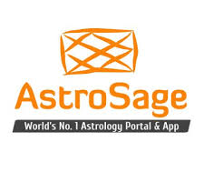
About us
AstroSage is one of the most authentic astrology destinations for not only those who are seeking astrological assistance, but also for high-level astrological research and development on wide scale. It is a prolific astrological source for people to help them out from mundane questions to specialized queries. Our aim is to ameliorate those who are facing problems and betterment of humanity using divine science of astrology.

Slide 4
PROBLEM STATEMENT
AstroSage has received a 1 crore investment and aims to optimize its call center operations. The goal is to determine how to allocate this investment to maximize operational efficiency, customer satisfaction, and profitability. The analysis will consider historical call data, performance metrics, and market trends to make informed decisions.

Slide 5
AstroSage Data snapshot
Data Cleaning and Preprocessing Steps:
Spell checking: Found out the typos and renamed them using FIND AND REPLACE.
Standardizing Date and Time Formats.
Categorization: Grouped data by key attributes.
Aggregations: Used aggregated functions like SUM, AVERAGE, and COUNT to calculate total call volume, average call duration, and agent performance metrics.
The dataset contains a comprehensive set of attributes related to operations, including call details, agent detail, customer ratings, and financial transactions.
The dataset provides insights into:
Call Volume Trends.
Agent Performance: Understanding the workload distribution and efficiency of agents.
Customer Satisfaction: Correlating various factors with customer ratings to identify areas for improvement.

Slide 6
Analytical approach and Tools
Data cleaning
Data Visualization
Data Analysis
Data Cleaning: Utilized functions like TRIM and REMOVE DUPLICATES to ensure data accuracy.
Data Enrichment: Extracted date and month from DateTimestam using INDEX function, for date and month based analysis.
Descriptive Analysis: Employed Pivot Tables for summarizing key metrics and identifying user volume patterns across different dates.
User Segmentation: Applied SORT and FILTER functions to classify users based on consultation type and call/chat status. And also found out the repeat users.
Visualization: Created dynamic charts and dashboards for data representation, enabling interactive data exploration.

Slide 7
Volume Analysis
Date 15/12/2023 recorded the highest single day volume of 1324 users.
Daily average call volume was 250 and daily average chat volume was 574.
Out of total agents, 60% agents handled 2 or fewer calls everyday.
Overall 3 daily avg. calls were handled by one guru.
Avg. completed daily call volume for January and December month were 48 and 107 respectively.

Slide 8
Financial Analysis
Highest one day revenue was 12,970 on 19/12/2023.
Gurucool website generated 59% of the total revenue.
Astrologer Dr.Balkrishna is the highest earner.
Daily avg. revenue is 6,294.
Total operation cost was 2,13,987

Slide 9
Consultation Status Analysis
32% of the calls were completed: This indicates that only one-third of the calls were successfully finished.
27% were incomplete: This high percentage of incomplete calls, points to disruptions or technical issues during the consultations, leading to lower customer satisfaction.
30% failed: This is a significant proportion, representing failed connections or calls that couldn’t proceed as planned. it can drastically affect the overall performance and user experience.

Slide 10
AstroSage Call center vs AstroGuru
AstroSage call center on an average handles 102 in user volume daily whereas AstroGuru handle 163 users.
AstroGuru agent handle 7 users on an average daily whereas AstroSage call center’s agent handle 4 users.
AstroGuru got an average rating of 7 from their users whereas AstroSage call center got an average rating of 3.5 from their users.
AstroGuru performed better than AstroSage call center as they got 60% more volume, 75% higher agent performance and 100% higher ratings.

Slide 11

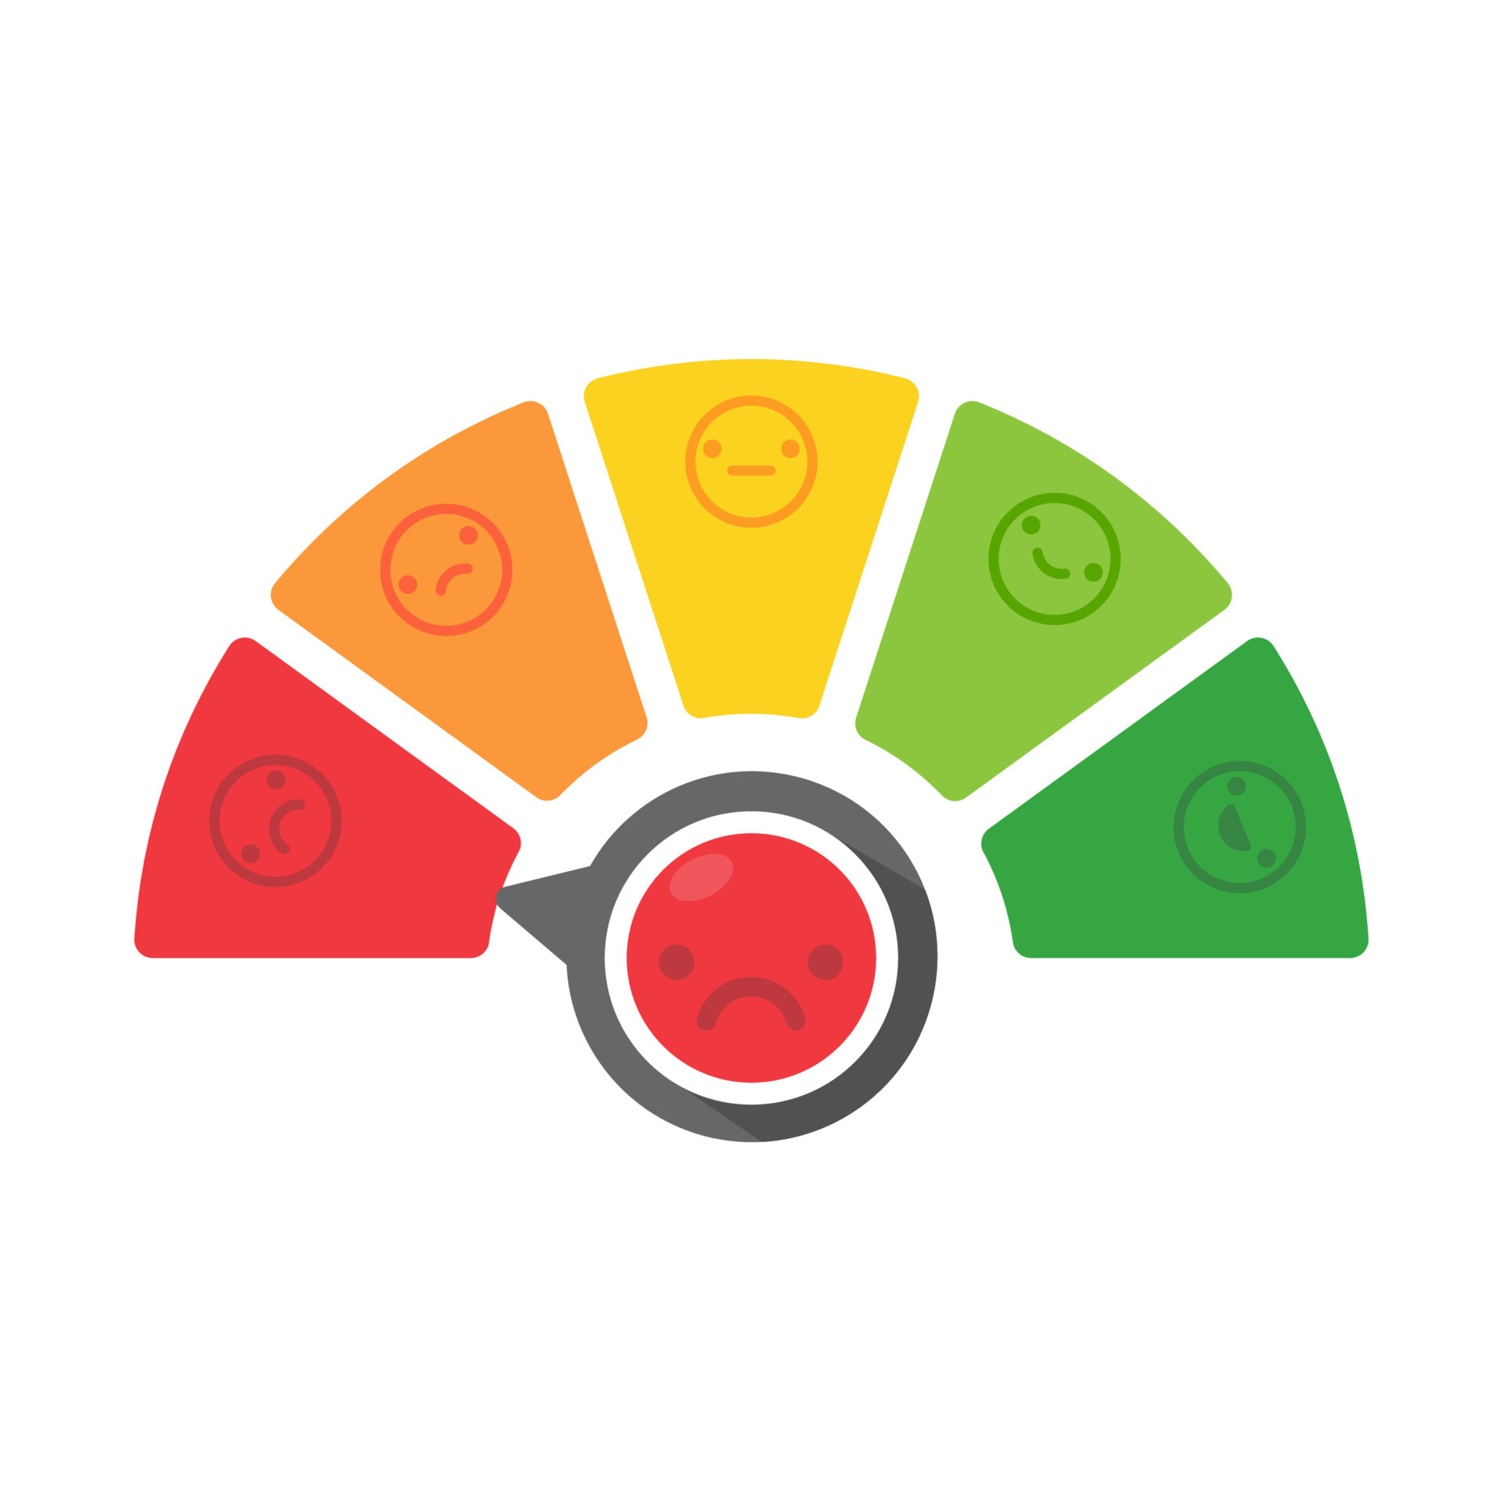

Insights from Historical Data
Low Average Calls Handled per Agent:
Agents handling an average of only 2-3 calls per day and over half of the agents handling 2 or fewer calls, there is a clear opportunity to improve agent utilization.
Moderate Customer Satisfaction Scores:
The average customer satisfaction rating is 2.8, indicating room for improvement in how agents handle calls, resolve issues, and communicate with customers.
High Call Volumes During Peak Periods:
Certain day of the week experience significantly higher call volumes, leading to longer wait times, and lower customer satisfaction.

Slide 12
There is always a room for improvement.
- Joey Lagano

Slide 13



Strategic Recommendations
1: Introduce Training Programs
Focusing on enhancing Guru’s knowledge and customer handling skills to boost customer satisfaction.
Impact: Increase customer satisfaction score.
2: Optimize Agent Utilization
Implement advanced call routing to balance workload.
Impact: More efficient handling of peak call periods, reduced agent burnout.
3: Invest in Technology Upgrades
Introducing tools like AI-based chat bot, call routing and automated feedback systems.
Impact: Faster resolution time, better resource management.

Slide 14
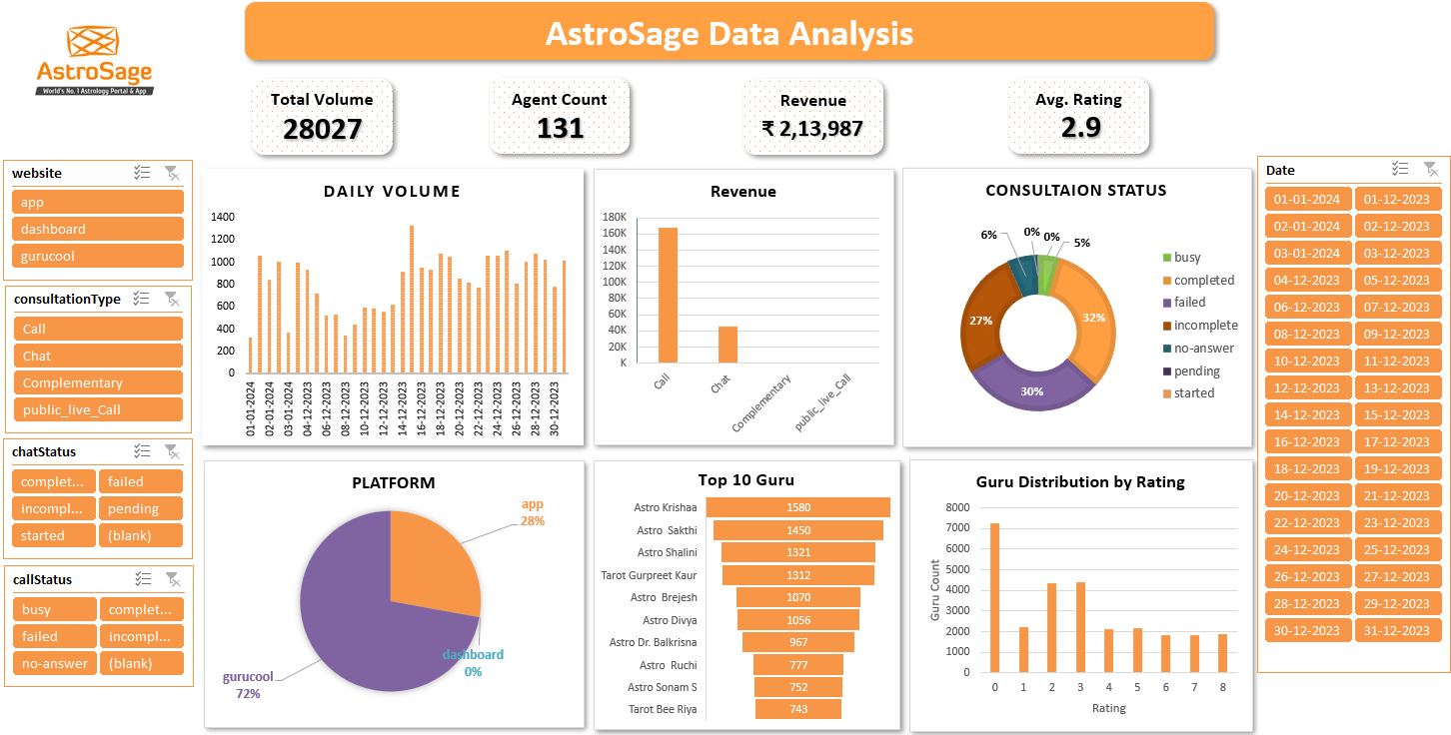
Dashboard

Slide 15
Conclusion
The analysis reveals critical areas for optimization in training, workload management, and technology.
Implementing these recommendations could potentially increase overall efficiency and customer satisfaction, thus increasing revenue and overall company growth .

Slide 16
References
AstroSage Report
Software Used: MS Excel v2408
https://www.alliedmarketresearch.com/astrology-market-A31779#:~:text=The%20global%20Astrology%20Market%20Size,widely%20practiced%20around%20the%20world.

